Slide 1


Front End Software Development
Orientation

Slide 2
Instructor - Introductions
Instructor Introduction
Student Introductions

Slide 3
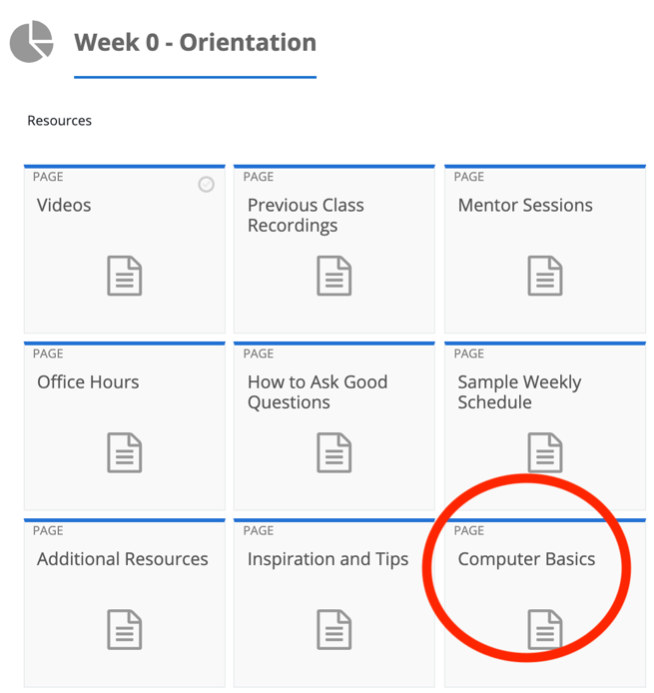
Prerequisites
Files
Folders
Command Prompt / Terminal

Slide 4
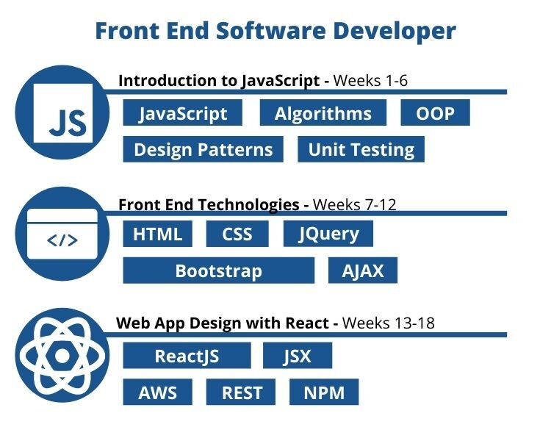
Summary of Program​
Week 0 – Orientation (this week)
Introduction to JavaScript (weeks 1 - 6)​
Front End Technologies (weeks 7 - 12)​
Web App Design with React (weeks 13 - 18)​
Career Services Assignments (Every other week)

Slide 5

Class and Assignments
Academic week starts on Sunday and ends on Saturday​
Assignments are due end of day Saturday at midnight​
First set of assignments (Week 0 – Orientation Course) are due this coming Saturday at midnight

Slide 6

Class and Assignments Continued​
Class is every [day] from 7PM to 8:30PM​
Watch all videos before class​
Start homework before class​
Come to class with questions
Do the quizzes last, after all other assignments are done

Slide 7
Grading
Grading is done by dedicated graders, not the instructor
10% deduction per day for late submissions​
Course completion requires: 70% grade average for each course, mastery level completion for all Open Class assignments, submit all other assignments
The goal is to learn the material, don’t worry about too much if you lose a few points here or there
Employers aren’t interested in your score. They want to hire graduates who understand the material

Slide 8
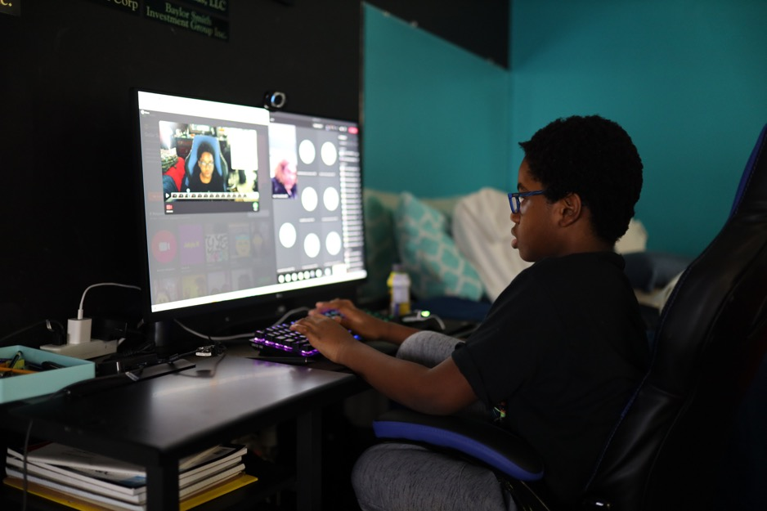
Videos
Code along with the videos
Write your notes as comments
Save your code on Github for reuse later!

Slide 9

Pro Tip – Reuse Your Code
Any code you write from the videos can be reused later for quizzes and assignments. Don’t rewrite code from scratch if you don’t have to!

Slide 10

Sources for Help
Google​
Classmates​
Mentors
Office Hours​
Cohort Channel in Slack

Slide 11
Posting Questions in Slack
Use your cohort’s slack channel to post questions. The channel name follows this format: 2022-01-fesd-schoolname.

Slide 12

Tips for Posting Questions
Show your code and error messages with line numbers
Explain the problem you are trying to solve​
Explain what your code is actually doing
Describe what solutions you have tried
Once you solve the problem, share the solution

Slide 13
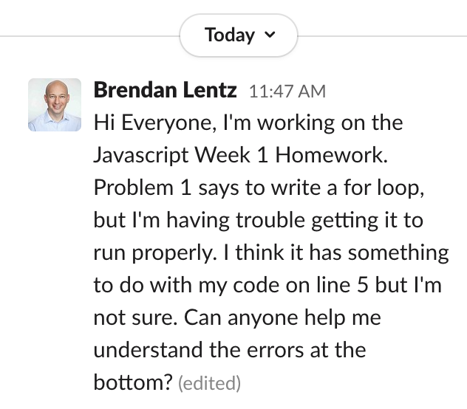
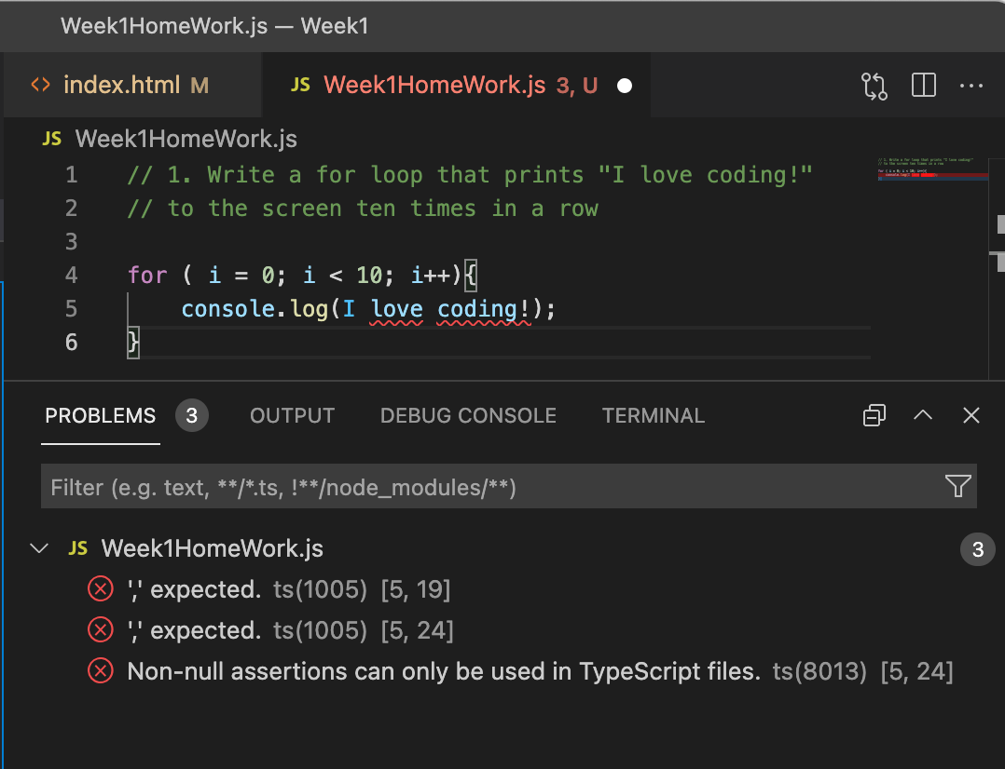
Example of a Well Written Question

Slide 14
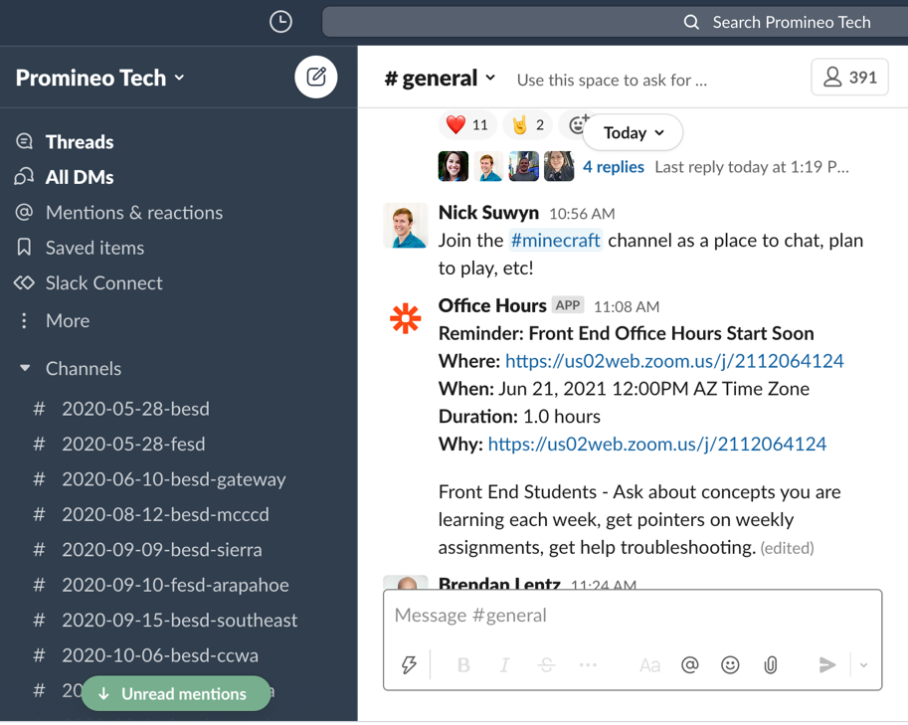
Slack Etiquette
Add a picture of you to slack profile (not your pet please)
Use your real name as your display name on slack
Treat Slack as a professional environment when it comes to language
Don't have any assumptions about privacy
Use Slack to get to know each other, share knowledge and advice, and solve problems together!
Slack can be fun! share some funny posts, gifs, any water-cooler chatter
Message history is eventually erased, please be sure to save anything you want to keep elsewhere

Slide 15

Zoom Etiquette
Be present
Real Names
Cameras on if possible
Mute when not speaking

Slide 16
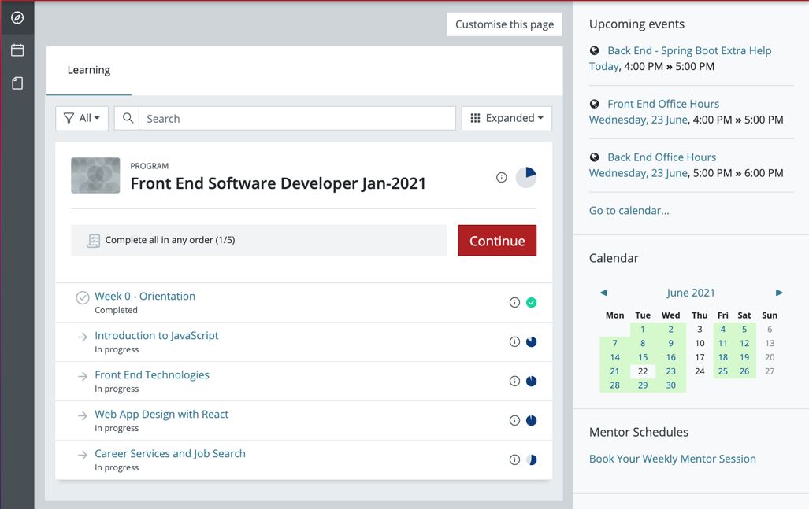
Tour of the Learning Management System (LMS)
https://learn.promineotech.com

Slide 17







Our Graduates Work At

Slide 18

Qualities of Successful Students
Committed to learning
Fully engaged
Supportive of others
Asks for help
Communicates clearly

Slide 19

Computer Basics
Keep your computer OS and software up to date
Have a backup strategy to store your data
Use Github to save progress for your coding

Slide 20

Pro Tip – Professional Behavior
Be on time
Be respectful
Assume that everyone you interact with has the potential to hire you or help you find employment

Slide 21

Pep Talk​
Can everyone answer the question – why are you in this program?
This program is difficult​
Create good study habits​
13 to 18 hours a week commitment
You are responsible for your own success

Slide 22

Special Note on Software Installations
We strongly recommend you use the software development tools and versions shown in the videos and what is shown in these slides. Our mentors and staff are experienced with those specific tools, and they can support you with issues.
Notes:
Please make sure to help all the students go through the installation of the software above.

Slide 23

Installations​
VS Code
Slack (download desktop/phone app)
Git (command line version - Mac’s typically have this preinstalled)
Notes:
Please walk through the installations with the students and show them where to go and how to do the installs.

Slide 24
Questions?

